Slide 1

Deep Neural Network Design for Object Detection with Deep Learning for Airport Runway Operations
TEAM PSEUDO BOOM
TEAM ID: LTPL –TEAM-045

Slide 2
CONTENTS
OUR TEAM
PROJECT INTRODUCTION
ABOUT THE PROJECT
SUGGESTED REFERENCE PAPERS
PROJECT GOALS
PROJECT PROGRESS
ACCOMPLISHMENTS
ANALYSIS
ACTION TAKEN

Slide 3
CONTENTS COTD…
MODEL INTRODUCTION
PART 1: CONVOLUTIONAL LAYERS
PART 2: REGION PROPOSED NETWORK
PART 3: CLASSES AND BOUNDING BOXES PREDICTION
CONVOLUTIONAL LAYERS
VGG -16 CONV NET ARCHITECTURE
FINDINGS AFTER TRAINING VGG - 16
ZFnet CONV NET ARCHITECTURE
FINDINGS AFTER TRAINIG ZFnet

Slide 4
OUR TEAM : PSEUDO BOOM
Prajval P : LTPL – INTERN – 0192
Shourya Mishra : LTPL – INTERN – 0204
Shwetha G P : LTPL – INTERN - 0208

Slide 5
PROJECT INTRODUCTION
Deep Learning is an AI function that imitates the working of the human brain in processing data and creating patterns for use of decision making.
It is a subset of ML in AI that has networks capable of learning unsupervised from data that is unstructured or unlabelled.
In recent times DL has expanded its area of applications and is now used in almost all the major fields and there are researches being made to improve its functionality.
Deep Neural Networks are already used in many real-world image classification applications, in this ML project we aim to crank it up a notch.

Slide 6
ABOUT THE PROJECT
In this ML project, we will solve the problem of object detection by leveraging DNNs.
We will develop a model that can both classify objects and also accurately localize objects of different classes.
The task of object detection is going to be treated as a regression problem to object bounding box masks. It would be a multi-scale inference procedure that can generate high-resolution object detection at minimal cost.

Slide 7
SUGGESTED REFERENCE PAPERS
Girshick R, Donahue J, Darrell T, et al. Rich Feature Hierarchies for Accurate Object Detection and Semantic Segmentation
Girshick R. Fast R-CNN
Ren S, He K, Girshick R, et al. Faster R-CNN: Towards Real-Time Object Detection with Region Proposal Networks
P. F. Felzenszwalb, R. B. Girshick, D. McAllester, and D. Ra-manan. Object detection with discriminatively trained part based models
Sande KEAVD, Uijlings JRR, Gevers T, et al. Segmentation as selective search for object recognition
Redmon J, Divvala S, Girshick R, et al. You only look once: Unified, real-time object detection
Dai J, Li Y, He K, et al. R-FCN: Object Detection via Region-based Fully Convolutional Networks
He K, Zhang X, Ren S, et al. Deep Residual Learning for Image Recognition

Slide 8
MODEL INTRODUCTION
After a thorough literature survey we came to the conclusion that using Faster RCNN would be the most viable option to proceed further with the task given.
The Faster RCNN is an object detection architecture presented by Ross Grishick, Shaoqing Ren, Kaiming He and Jian Sun in 2015, and is one of the famous object detection architectures that uses convolution neural networks like YOLO (You Look Only Once) and SSD ( Single Shot Detector).
The architecture of Faster RCNN will consist of 3 parts.

Slide 9
PROJECT GOALS
Literature Research
Data Collection
Data Visualization and Data Cleaning
Gain insights
Designing the Deep Neural Network
Extended Literature Research for Optimization
Training the algorithms
Testing the algorithms
Compare performances
Conclude Results

Slide 10
PROJECT PROGRESS
1) Considering numerous advantages of Faster R-CNN algorithm over other object detection algorithms, the team opted to use Faster R-CNN algorithm for the implementation.

Slide 11
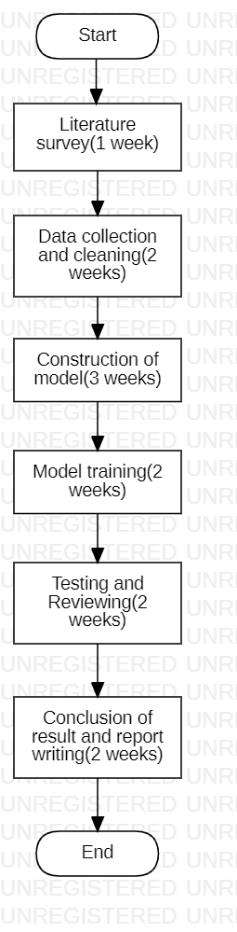
2) The work-flow designed for the project is,

Slide 12
3) The team referred many reference papers that are published about “Object Detection” for a week.
4) The team started collecting dataset from multiple resources to train the model, and ended up collecting dataset containing around 300 images of different classes of runway like debris, birds, hangar, people, baggage carriers, plane and tow tractor.
5) The team also cleaned the dataset to bring to suitable form for training the model.
6) Currently, the team is working on the construction and implementation of model.

Slide 13
ACCOMPLISHMENTS
The project is on track, as the work is being completed according to the workflow and time-liners.

Slide 14
ANALYSIS
While constructing the model, it was found that the dataset quantity that had been collected was not enough for the model training, as it required more data for appropriate object recognition.

Slide 15
ACTIONS TAKEN
To address this variance, the team worked on collecting more datasets from different sources for training the model.
The team achieved to collect 600 images of different classes.

Slide 16
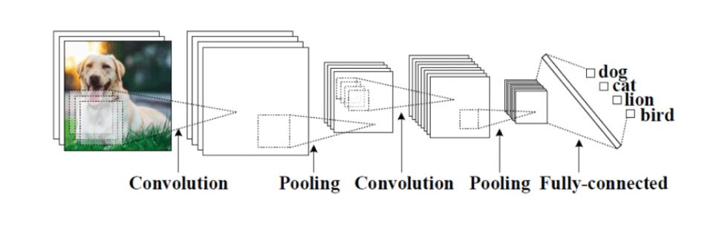
PART 1: CONVOLUTION LAYERS
Convolution networks are generally composed of Convolution layers, pooling layers and a last component which is the fully connected or another extended thing that will be used for an appropriate task like classification or detection.
We compute convolution by sliding filter all along our input image and the result is a two dimension matrix called feature map.
Pooling consists of decreasing quantity of features in the features map by eliminating pixels with low values.

Slide 17
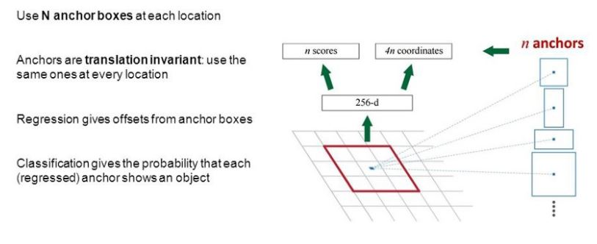
PART 2: REGION PROPOSED NETWORK
RPN is small neural network sliding on the last feature map of the convolution layers and predict wether there is an object or not and also predict the bounding box of those objects.

Slide 18
PART 3: CLASSES AND BOUNDING BOXES PREDICTION
We use another Fully connected neural networks that takes as an input the regions proposed by the RPN and predict object class ( classification) and Bounding boxes (Regression).
To train this architecture, we use SGD to optimize convolution layers filters, RPN weights and the last fully connected layer weights.

Slide 19
CONVOLUTIONAL LAYERS
After careful considerations we concluded that the following two models would be best suited for the PART 1: CONVOLUTIONAL LAYERS for the FASTER RCNN model design.
VGG – 16
ZFnet

Slide 20
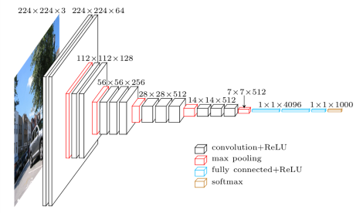
VGG – 16 CONV NET ARCHITECTURE
The parameters we have used are:
ImageDataGenerator for labels and to increase the data in the training by mirroring all the images we will make use of the horizontal flip feature.
BATCH_SIZE = 25
CLASS_MODE = ‘SPARSE’
OPTIMIZER is the RMSProp
Loss function used is the sparse categorical entropy.

Slide 21
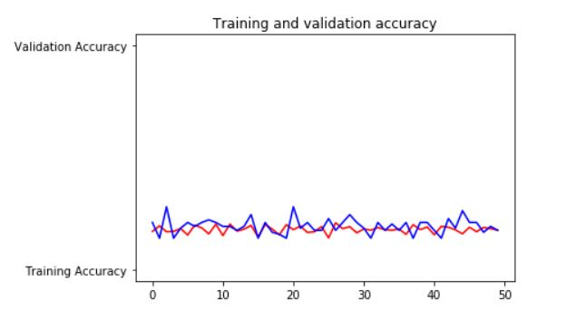
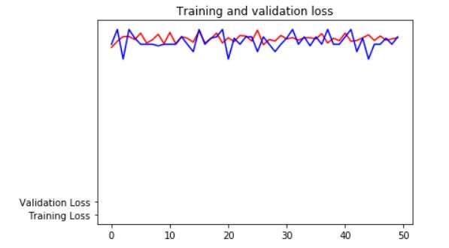
FINDINGS AFTER TRAINING VGG - 16
The graphs show the outcomes of training and validation considering 5 classes: for the training data set we had baggage_carriers(96 images), birds(95 images), hangar(117 images), plane(87 images) and tow_tractor(126 images) and for validation we used 5 images for each of the classes.

Slide 22
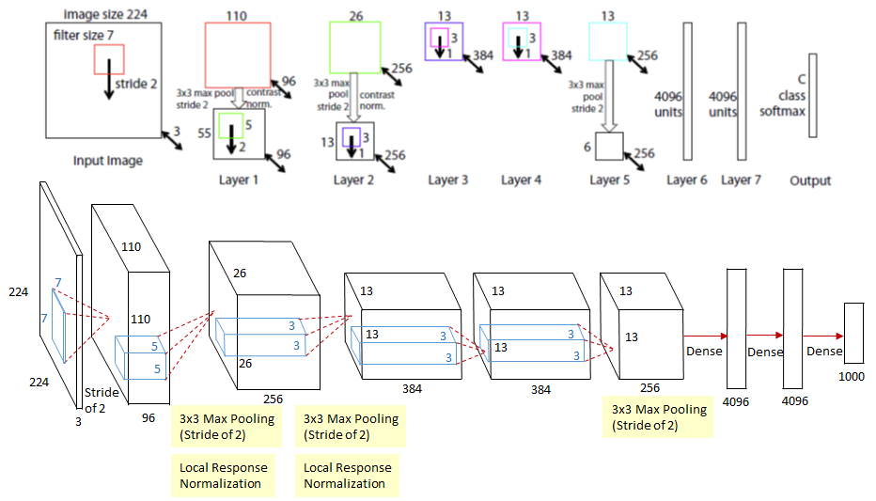
ZFNet CONV NET ARCITECTURE
Parameters Used :
Batch_size : 16
Epochs : 50
Class mode : Sparse
Loss function : sparse_categorical_crossentropy
Optimizer : RMSProp
Imagedatagenerator for expanding the dataset by horizontal flip

Slide 23

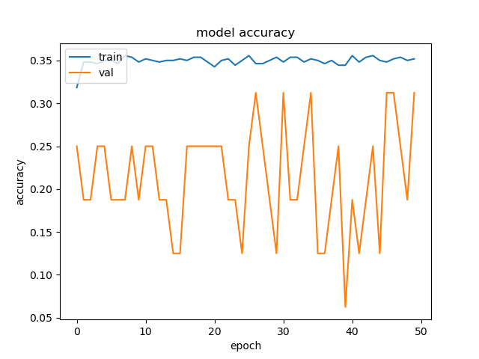
FINDINGS AFTER TRAINIG ZFnet
This is the graph plotted for class mode binary. The graph is between the epochs and accuracy of the model.
The graphs show the outcomes of training and validation considering 5 classes: for the training data set we had baggage_carriers(86 images), birds(100 images), people(80 images), plane(92 images) and tow_tractor(194 images) and for validation we used 5 images for each of the classes.

Slide 24
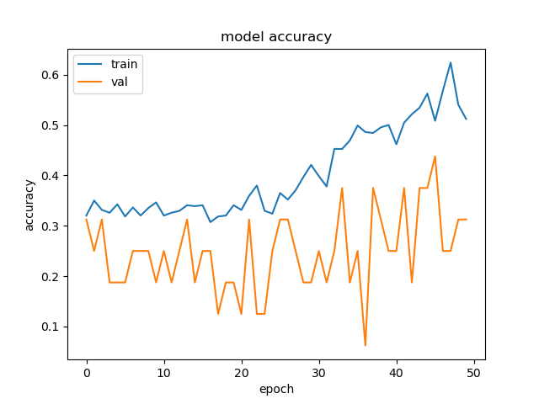
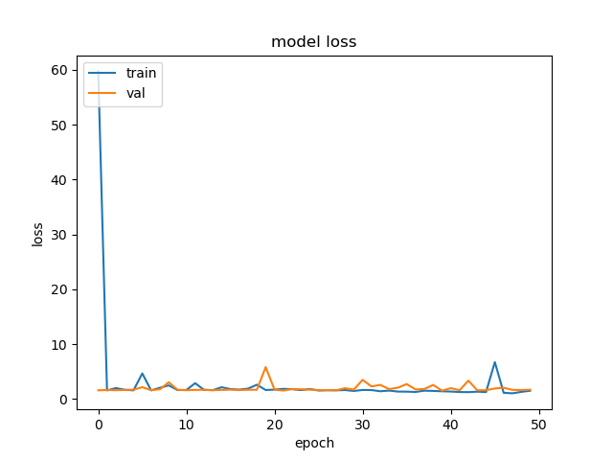
FINDINGS AFTER TRAINIG ZFnet
These are the graphs plotted for class mode sparse. The graph is between the epochs and accuracy/loss of the model.

Slide 25
THANK YOU

